Slide 1
Puma Aero Marine
Heavy Lift and Long Duration Co-axial Unmanned Aerial Vehicles

Slide 2
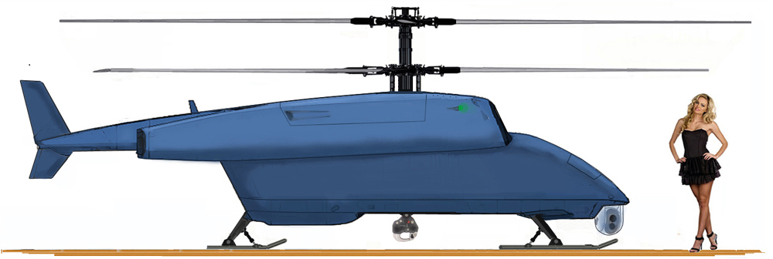
“The boss”
HEAVY LIFT DRONE COAXIAL HELICOPTER: (VTOL-UAV)

Slide 3
BOSS VTOL-UAV Objectives:
A rugged, stable, quiet, and cost effective all weather heavy lift platform to handle a wide variance of payloads. The Puma Aero Marine’s “BOSS” coaxial helicopter heavy lift drone (VTOL-UAV) is designed for both the public and private sectors. The “BOSS” can perform the following missions and many more:
  Heavy Exterior lifts (mobile sky crane loads to 1,206.3 kg./2,660 lbs./ 1.2 Metric Tons)
  Agricultural: aerial application using Variable Rate Technology
  Surveillance: Sea Hawk SHN-X9 Radar for detecting oil spills and/or surface ice
  Aerial firefighting: For rapid initial attack air tanker missions
  Search and Rescue Missions
  Airborne Laser Mine Detection System
  Seafood harvesting platform for side scan sonar devices to detect sea life

Slide 4
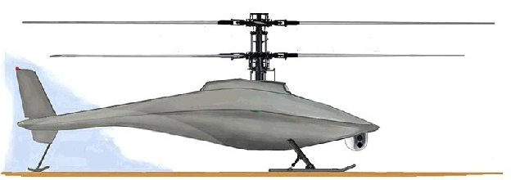
“The PUMA”
SURVEILANCE DRONE COAXIAL HELICOPTER: (VTOL-UAV)

Slide 5
PUMA VTOL-UAV OBJECTIVES:
A rugged, stable, quiet, and cost effective all weather surveillance platform designed primarily for the public sector. to handle a wide variance of payloads:
  A low cost VTOL-UAV platform with the capability of flying 68.1 kg. (150 lbs.) of surveillance equipment or other moderate weight sensors on eight (8) hour missions
  An inexpensive, reliable, environmentally friendly COAXIAL VTOL-UAV designed primarily for the public sector
  Easily operated by anyone with computer gaming skills, which receives its commands from a computer keyboard and override control by a fly by wire joystick. The operation could be from any operational base, dispatch center, mobile truck based unit, a vessel or carry around hand held unit
  Development of a model for use by private users such as Utilities/Farming/Forestry/Fishing and other industries requiring the use of aerial sensing systems.

Slide 6
Summary - Puma vtol-uav’s
  Puma Aero Marine of Florida and Bosonda International Ltd of California has developed an inexpensive, reliable, environmentally friendly line of COAXIAL VTOL-UAV (drone helicopter) platforms. The Puma VTOL-UAV’S are an inexpensive, reliable, and environmentally friendly line of COAXIAL VTOL-UAV (drone helicopter) platforms
  The heavy lift “BOSS” is designed for missions that require heavy lift capabilities. This can include missions that require large sensor packages, agricultural applications, sky crane lift duties, firefighting and search/rescue missions etc.
  The standard lift “PUMA” VTOL-UAV is designed primarily for missions requiring a moderate weigh sensor platform and extended duration flights
Both Puma VTOL-UAV designs are complete and is now gearing up for dynamic endurance testing of a full scale transmission and rotor head with blades. The next stage is to build and complete test flying prototypes within three months after completion of the endurance testing. The prototypes and any initial production models will require approximately two months flight and support equipment evaluations.

Slide 7
Design Features - Coaxial VTOL-UAV
High Useful Load:
The absence of a tail rotor in the Coaxial permits all of the engine power to be used by the rotor system for lifting purposes. Therefore, in comparison with a tail rotor configuration, the useful load of the Coaxial is higher. Multi-rotor configurations have substantially higher weight and higher transmission and shaft power losses than the Coaxial. The tandem configuration rotor system gives the Coaxial a useful load advantage over the tandem or any other multi-rotor configuration.
Safe Deck and Ground Characteristics:
In cross winds, on a rolling pitching and heaving ship’s deck, the handling of the Coaxial is much simpler than any other type, especially in takeoff and landings.
Low Empty Weight:
The feature that makes the fuselage independent of the lifting system dynamics permits the design of the fuselage to be strictly functional as related to mission requirements. This is the one feature that separates a Coaxial system from any other type.

Slide 8
Complete Symmetry of the Rotor System:
The symmetry of the Coaxial Rotor System permits the same aerodynamic efficiency and controllability for flight in any direction; a feature only found in the Coaxial.
Simplified Rotor System:
The Coaxial utilizes the semi-rigid type of rotor system without the need for the use of mechanical stabilizing devices, thus resulting in a simpler rotor system design and possessing excellent flying qualities.
Freedom from Control Cross-Coupling:
Control cross-coupling exists in all other rotor configurations, causing control complexity, dangerous flight attitudes, and vibration. Lack of control cross-coupling in the Coaxial yields multiple advantages in weight and performance compared to single rotor with a tail rotor and dual rotor systems.

